Slide 1

Presentation for
Construction Management Services
for the
Kenilworth Board of Education
Referendum Projects

Slide 2

About us
Our purpose is to provide our clients with a high level of comfort that their project is being effectively supervised to ensure the construction process is progressing in a manner that will set realistic expectations, instill a sense of confidence, and leave a feeling of accomplishment upon its completion.
Principals
Brian J. Meade and Keith R. Thompson - 50% Ownership each
Mr. Thompson began working as Project Executive in CM firm in 1990
Mr. Meade & Mr. Thompson began working together in 1996 at VCI, Inc.
Principals of Vincentsen Thompson Meade, Inc. 2001-2010
Started Legacy Construction Management, Inc. in 2011
Experience
Collective managed over 300 projects in 30 school districts, 12 municipalities, and various other public and private entities throughout New Jersey
In 2022 alone we managed work totaling over $100M
Provide Construction Management Services as Owner’s Representative only!

Slide 3
WHAT WILL LEGACY DO FOR YOU?
Mission
Learn the concerns and expectations of our Clients,
Understand the goals and objectives of the Project, and
Focus the Team on a successful delivery.
Lead the Team
Owner,
Architect and its Engineers,
Construction Manager,
Contractor and its Subcontractors, and
Various other Consultants, i.e technology, environmental, etc.
Identify Specific Project Challenges……and provide Solutions.
Proactive Approach
Ensure accountability of each Team member,
Recognize the potential for impacts on the schedule and on the budget,
Anticipate actions required to maintain progress,
Assist the Architect and Contractors to prevent delays and claims.
Maintain relationships with manufacturers
Reduce the Burden of Construction on our Clients
Reduces the burden on our Clients while keeping them fully informed
Customized Reporting
Legacy lends it expertise of the construction process and the construction contracts to coordinate the efforts of the Team and to ensure that each Team Member performs its responsibilities to avoid delays and cost overruns.

Slide 4

SCHEDULE & PHASING
Package #2 HVAC
Bid March 2023
Coordinate Milestone Dates with Football, Baseball, Softball, Soccer seasons.
Package #1 Fields
Bid August 2023
Longest Lead Times
Package #3 Add. / Alt.
Bid August 2023
Coordinate with regrading fields due to staging
Procurement
Switchgear Min. 52 weeks
480V Panels Min. 52 weeks
Transformers 18-24 weeks
Unit Ventilators (UV’s) 20 weeks +/-
Rooftop Units (RTU’s) 30 weeks +/-
Bidding Strategy
Package 1: Field Improvements, $4.5M
Package 2: HVAC Improvements, $5.5M
Package 3: Additions & Alterations, $16.1M
School Programs
Work that must be performed during the Summer vs. work that can take place during the school year

Slide 5
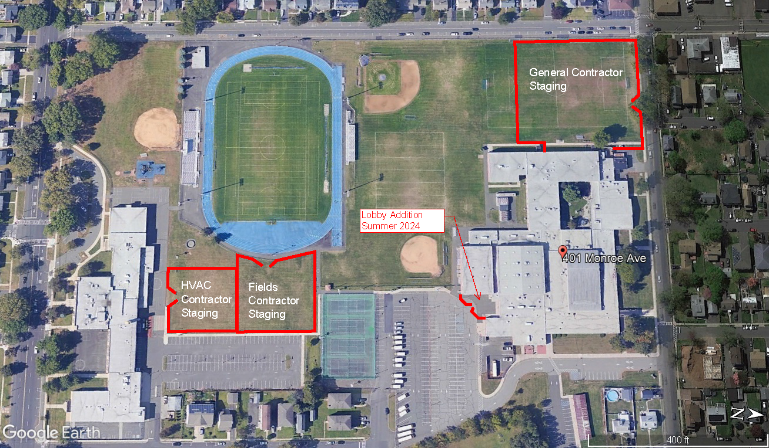
STAGING & LOGISTICS

Slide 6
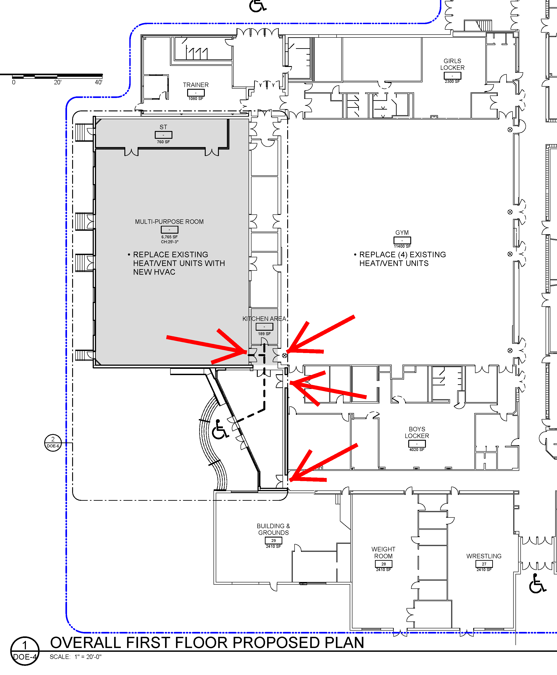
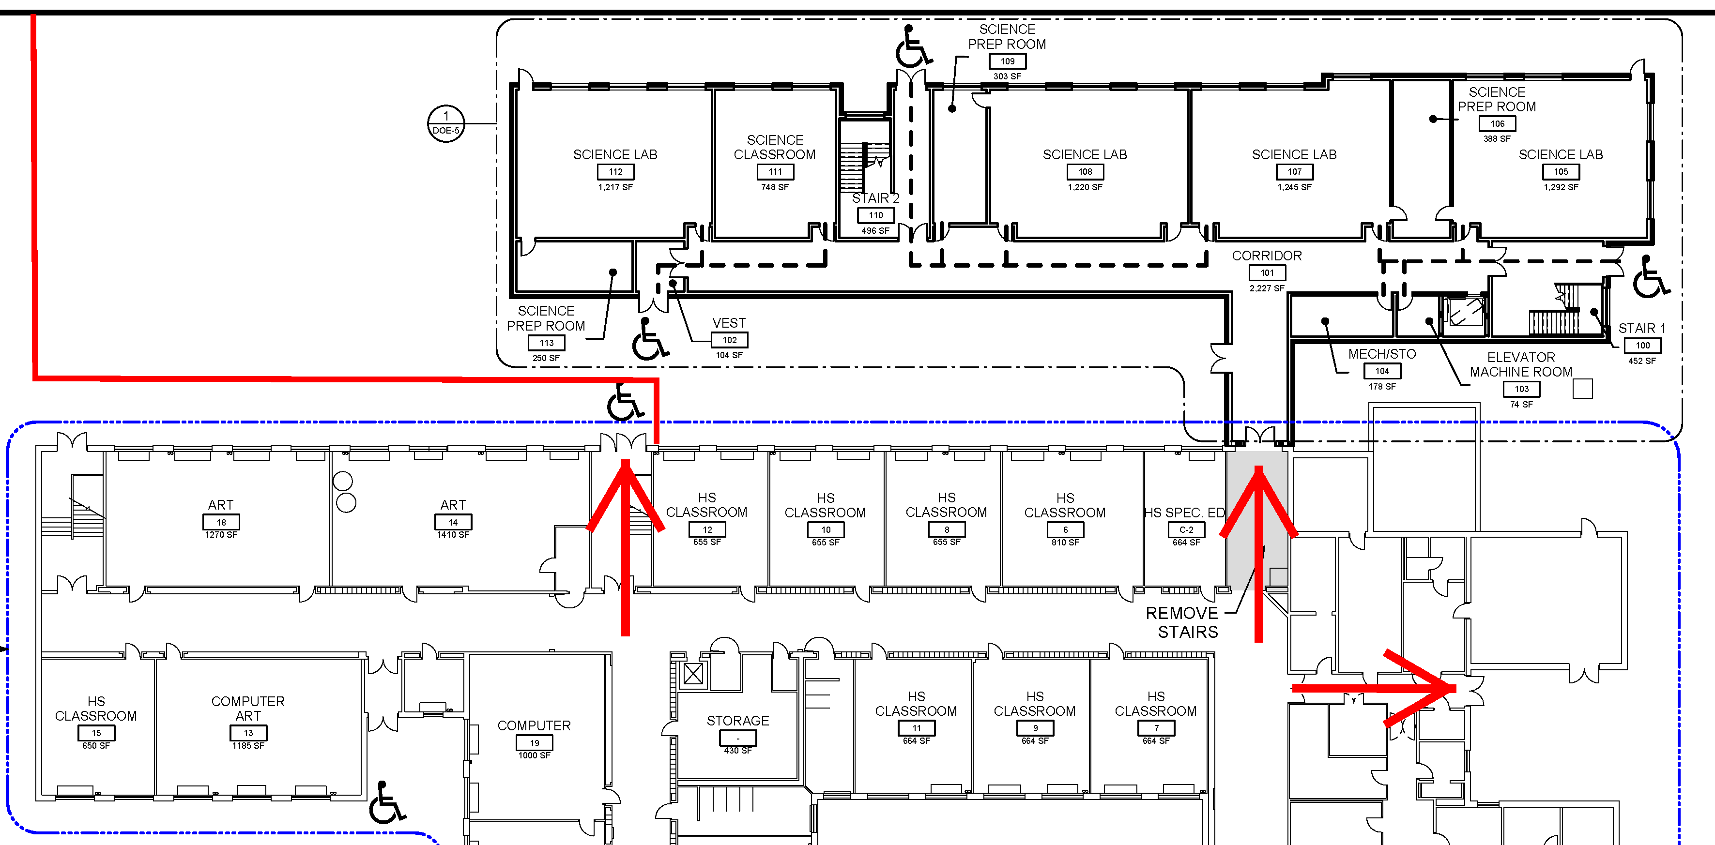
STAGING & LOGISTICS

Slide 7
Communications & Reporting
Goal:
Establish stringent protocols that will ensure the flow of factual information for effective management
Communication with the Contractor:
Legacy funnels information to the Owner
Coordination between the District, Architect, and Contractor
Establish the Owner’s Primary Points of Contact
Reporting to the Board by Legacy:
Progress on the job
Schedule
(Potential) Impacts
Budget
Photos
Reporting to the Public:
Recommend a page on District website
Legacy will provide reports and photos to be uploaded
Updated regularly – monthly or twice per month
Attend public meetings
Legacy
Owner
Contractor
Architect
Public

Slide 8
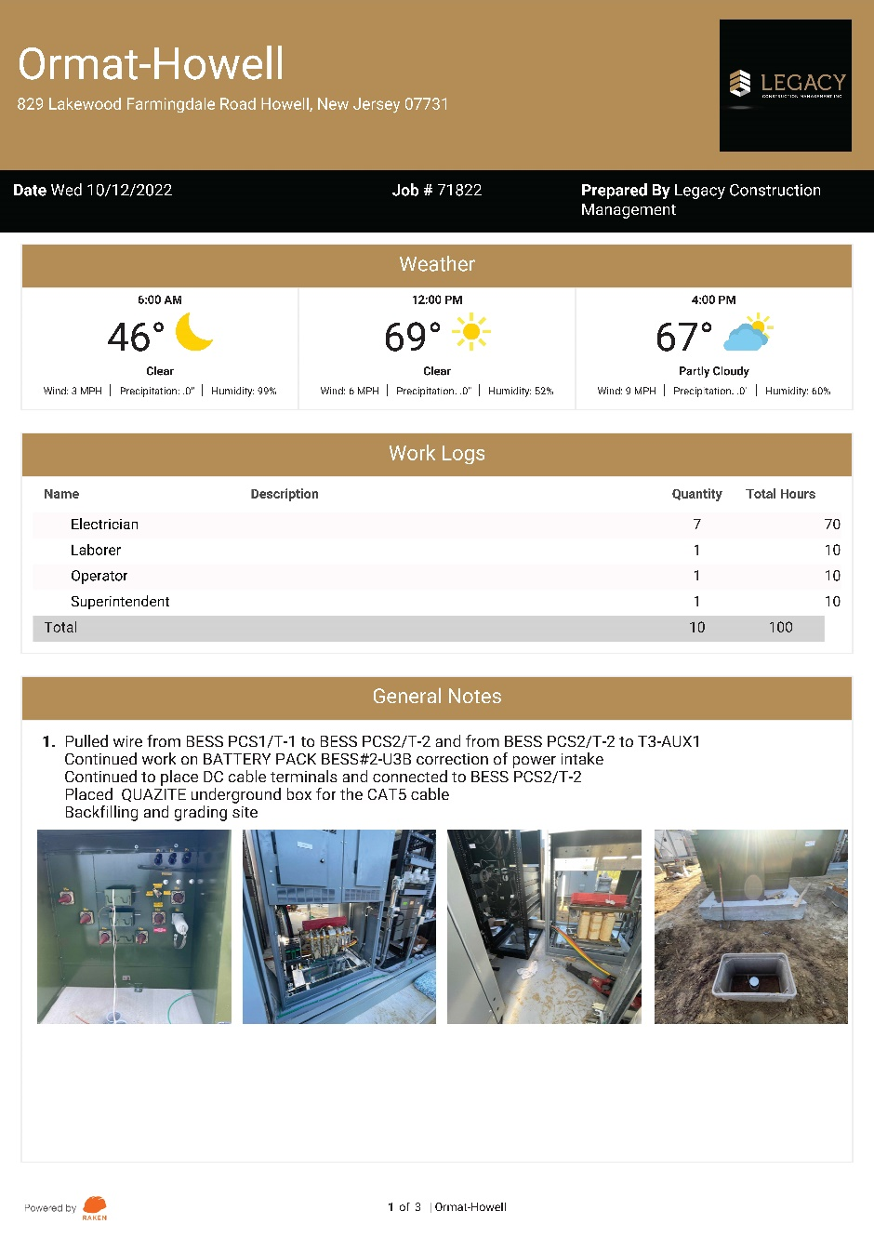
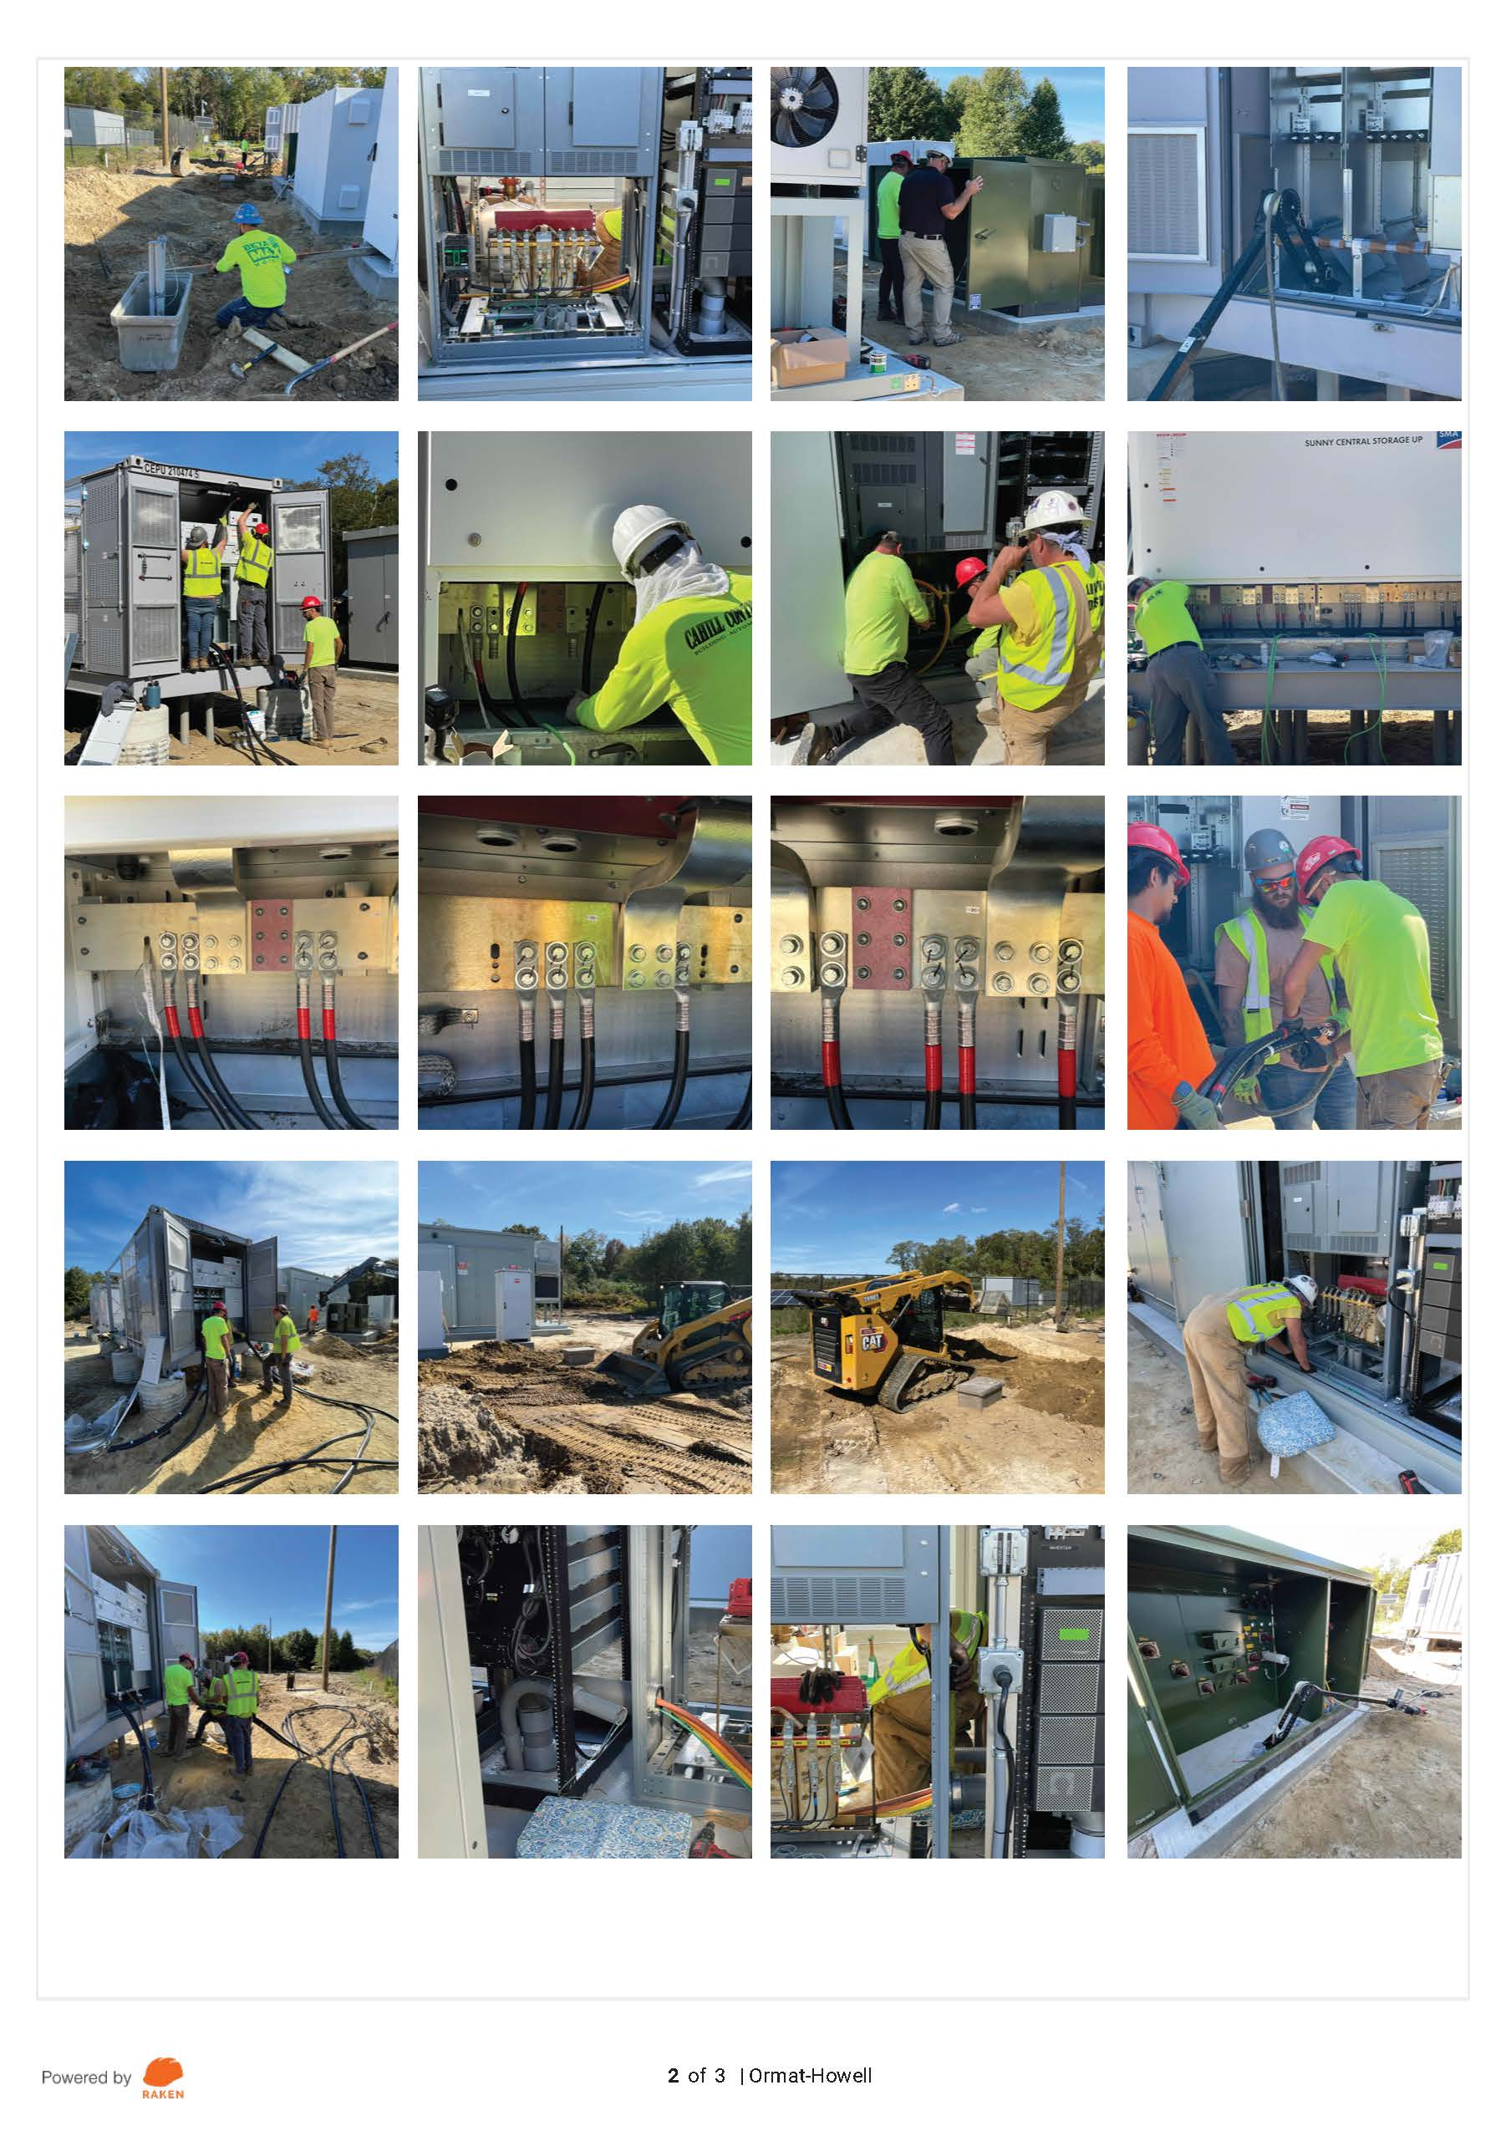
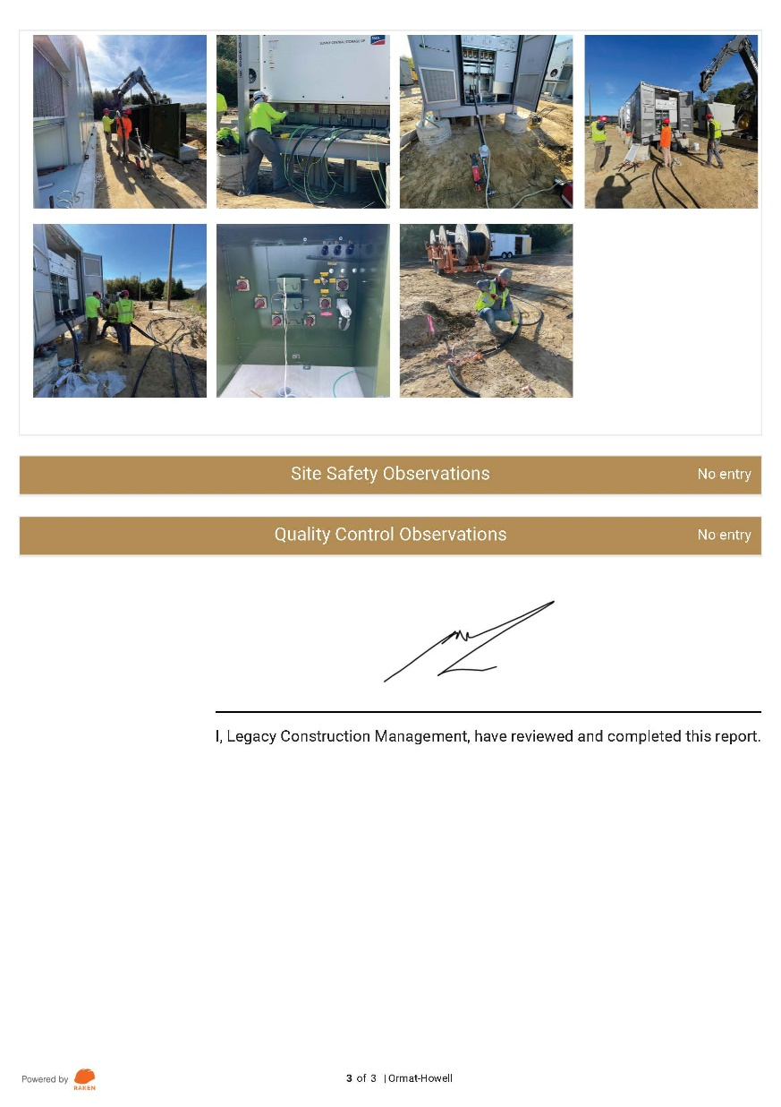
Reporting – Daily Report

Slide 9
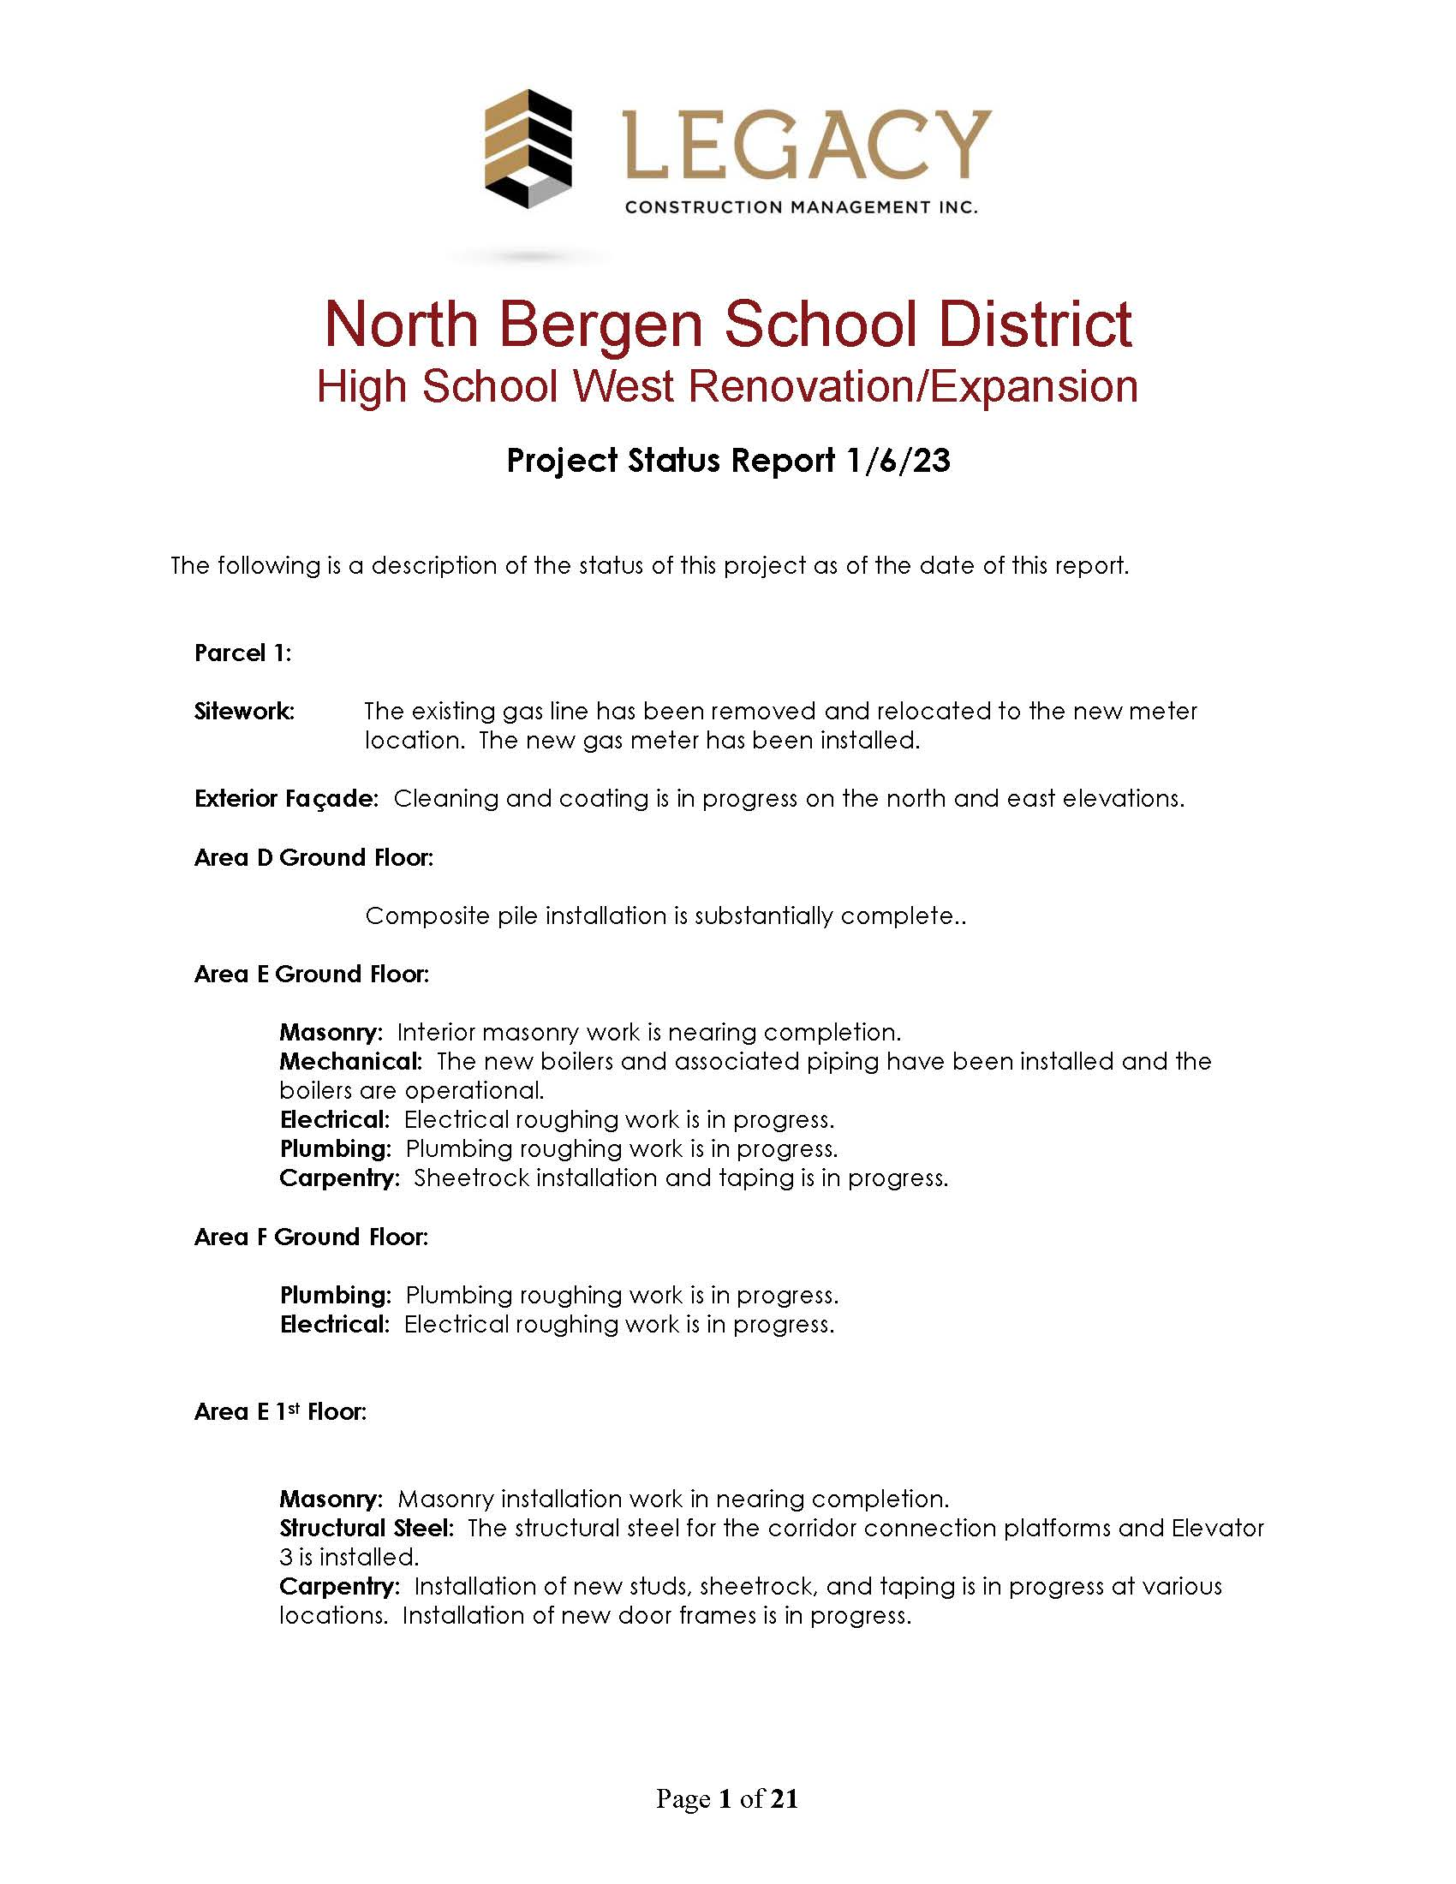
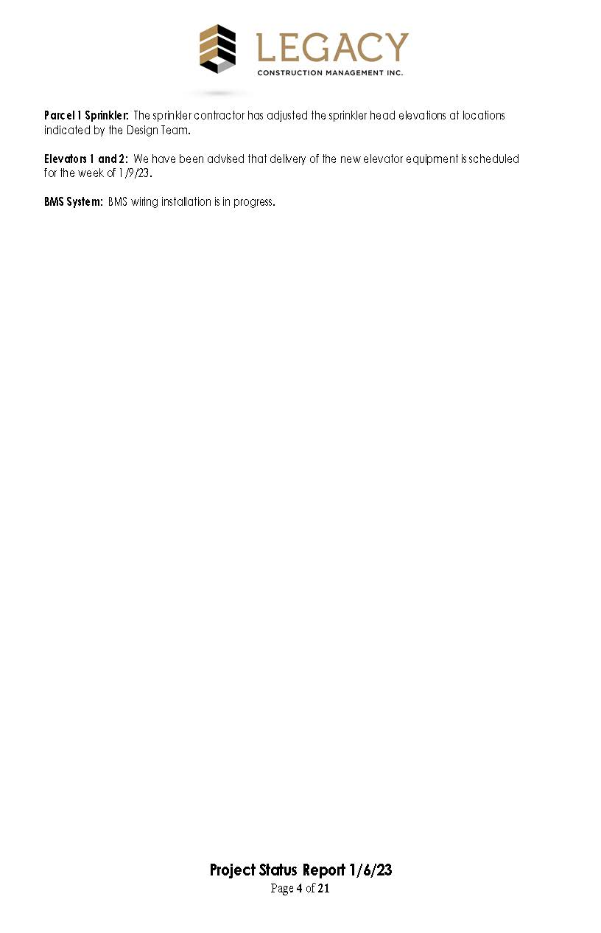
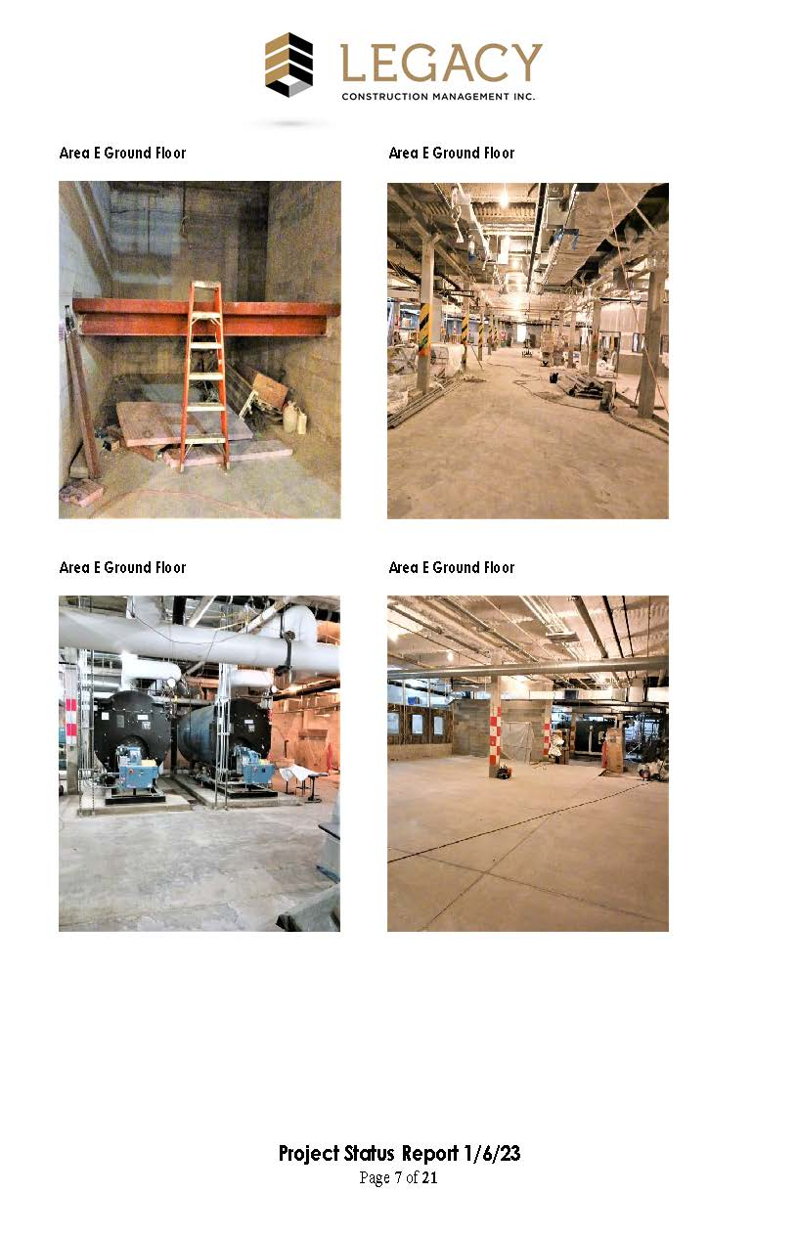
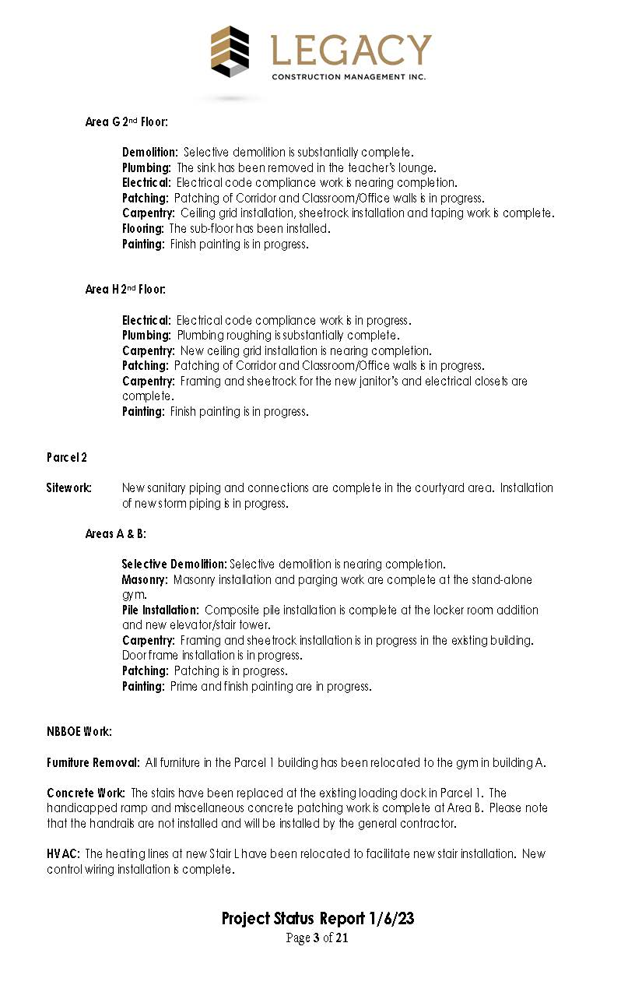
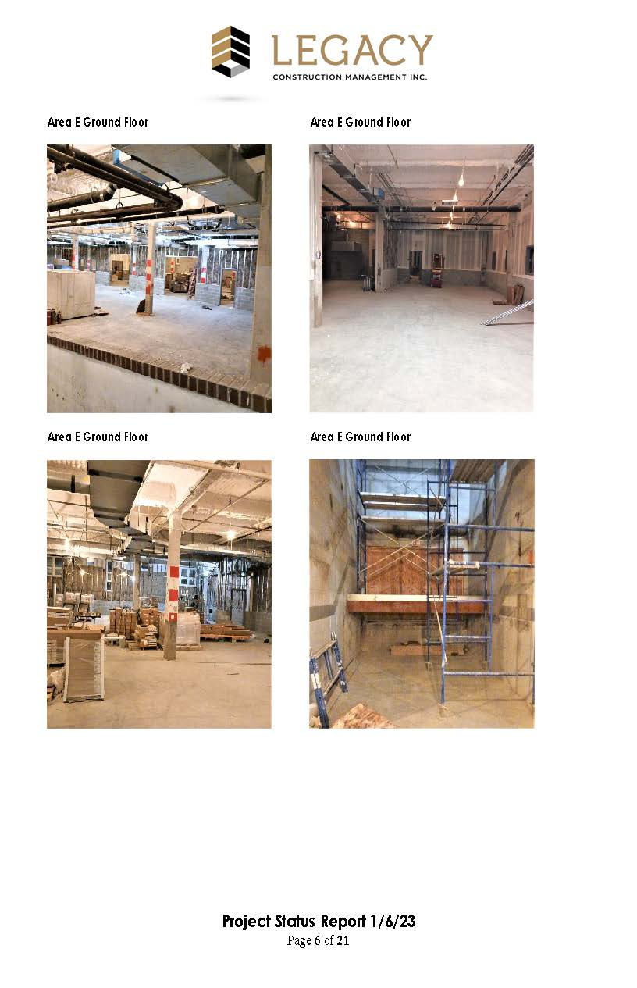
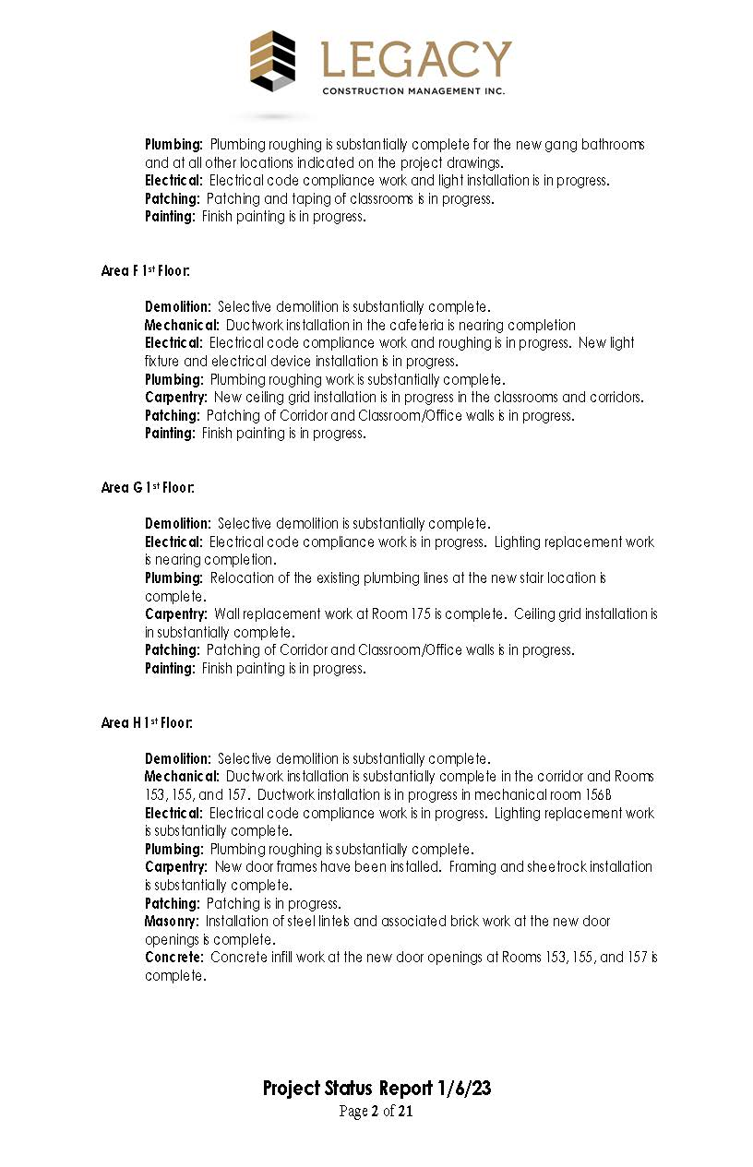
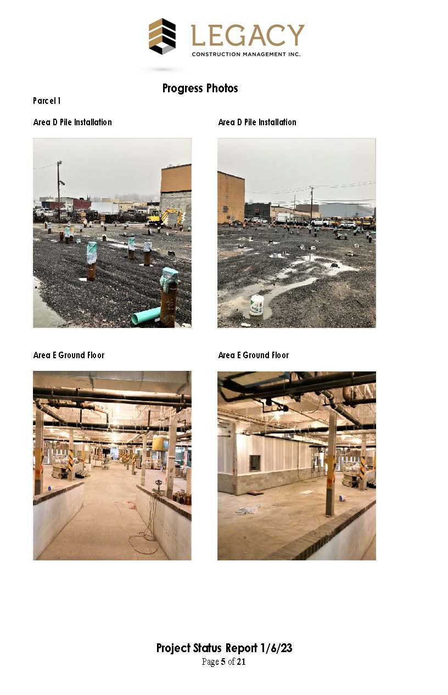
Reporting – semi-monthly report

Slide 10
Student / Staff Safety & Site Logistics
Goal:
Isolate the Students and Faculty from the Construction!
Implementation:
Background Checks
Contractor Badge system
No communication between contractors and students/facility
Interaction with local police/fire officials
Construction Fence & Contractor Access
Construction Staging & Contractor Parking
Student Access & Circulation routes
Staff & Visitor parking
Bus routes & Parents drop off
Temporary lighting and signage
Building security
Fire safety
Emergency egresses
Temporary partitions & Dust partitions
Utility shutdown and tie in
Holiday & vacation planning
Student/facility occupation
Summer Programs
Project Logistics Program:
Identify Potential Impacts
Develop Phasing Plan
Create Site Logistics Plan

Slide 11
On-Site Project ManageR
Responsibility:
Ensure that the Work is being performed in accordance with the Contract Documents
Tasks:
Owner’s Primary Point of Contact on site
Coordination between the Owner, Architect, and Contractor.
Monitor the Quality of Construction
Liaison with Building Inspectors
Monitor Site Logistics for Public Safety
Prepare Daily Field Reports with Photographs
Maintain Outstanding Items List
Construction Document Management
Maintain Shop Drawings and Submittals
Review Proposed Change Orders
Track Requests for Information (RFI’s)
Monitor Construction Schedules
Manage Independent Testing
Maintain As-Built Drawings
Coordinate Owner’s Training
Punchlist
Legacy
Owner
Contractor
Architect

Slide 12
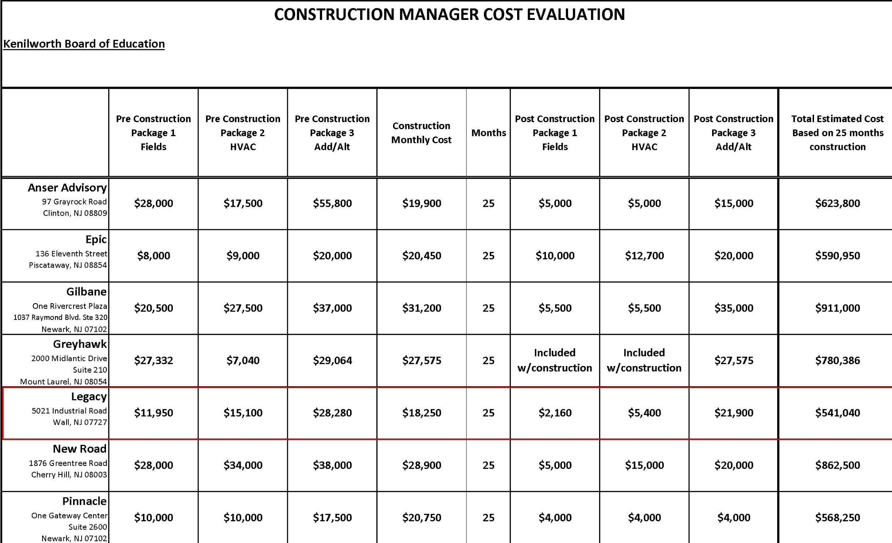
construction management fees

Slide 13
In closing……
Goal for Key Results:
Minimize the Burden of Construction
Satisfy the Owner’s Concerns
Good Communication
Positive Experience for Kenilworth Board of Education
Work as Team Player
Complete the Projects On Time and On Budget

