Slide 1
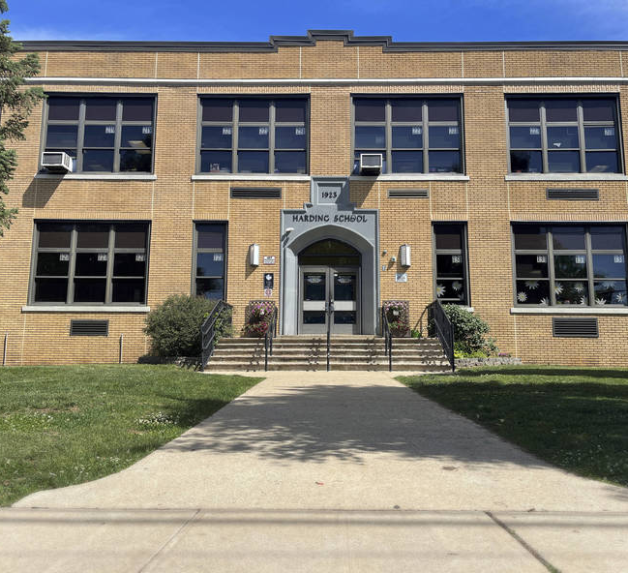
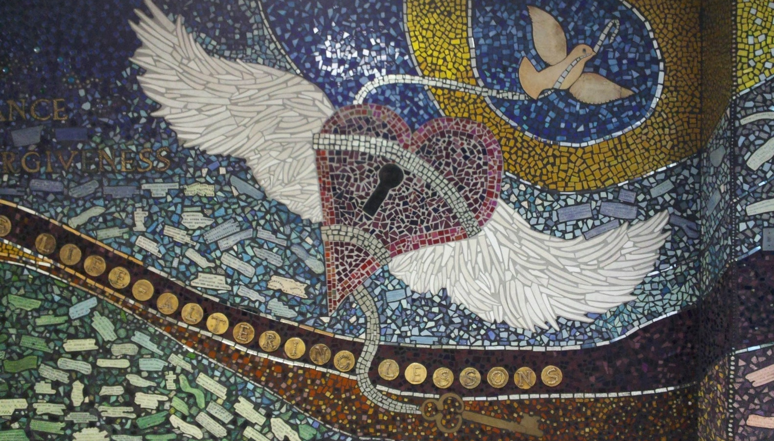

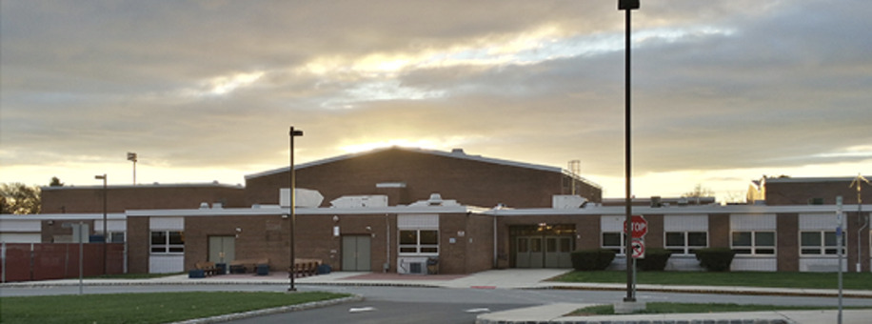

On-Site Construction
Management Services
ADDITIONS AND ALTERATIONS AT
DAVID BREARLEY MIDDLE/HIGH SCHOOL & WARREN HARDING ELEMENTARY SCHOOL
HVAC UPGRADES AT DAVID BREARLEY MIDDLE/HIGH SCHOOL &
WARREN HARDING ELEMENTARY SCHOOL FIELD IMPROVEMENTS
AT DAVID BREARLEY MIDDLE/HIGH SCHOOL
RFP # 2023-02
January 31, 2023

Slide 2
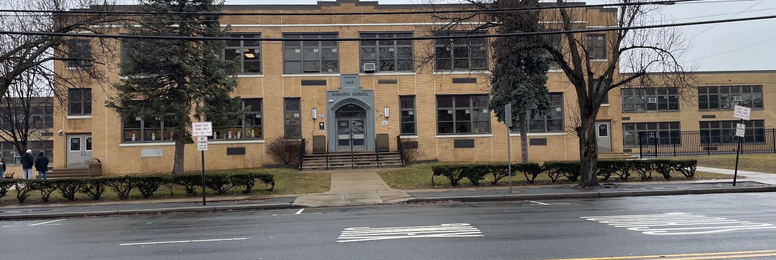

Introducing Anser Advisory
STRONG BENCH STRENGTH
LOCAL
EXPERTISE
Over 25 years providing full construction management services to public educational clients
90% of business revenue derived from repeat business with our clients
Over $1.5 billion in construction value providing services from our New Jersey office
Prequalified by the New Jersey Treasury Department Division of Property Management and Construction (DPMC) and New Jersey Schools Development Authority for projects of unlimited value
1,200+ Employees Nationwide
Ranked at #14 on ENR’s 2022 Top 50 Program Management Firms
Focused solely on advising and managing capital projects for owners
Strong financial stability and capacity to support the contract long-term
Five Northeastern Offices
Over $50 billion in capital program management nationwide
We are strategic thinkers and complex problem solvers

Slide 3

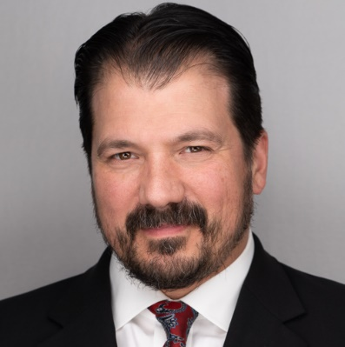
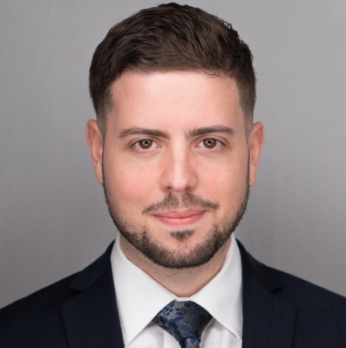
Your Dedicated Team
Dan Connelly
CCM
Project Executive/
Managing Director
Principal-in-Charge
John Calabrese
Senior Project Manager
Primary Point of Contact
Full Time On-Site Manager
Randy Garcia
Asst. Project Manager
Project Administration
Over 20 years of industry experience
Extensive K-12 project experience
Experience with occupied addition/ renovation projects
Strong local knowledge
OSHA 30-Hour Certified
Over 7 years of industry experience
Administrative management
Applied best practices through a hands-on approach
OSHA 30-Hour Certified
Versed in all PM platforms
Over 25 years of industry experience
Leadership and resource management
Resource allocation and contract administration
Notes:
Who you are, what your credentials/background/years of experience, recent similar projects, strengths

Slide 4
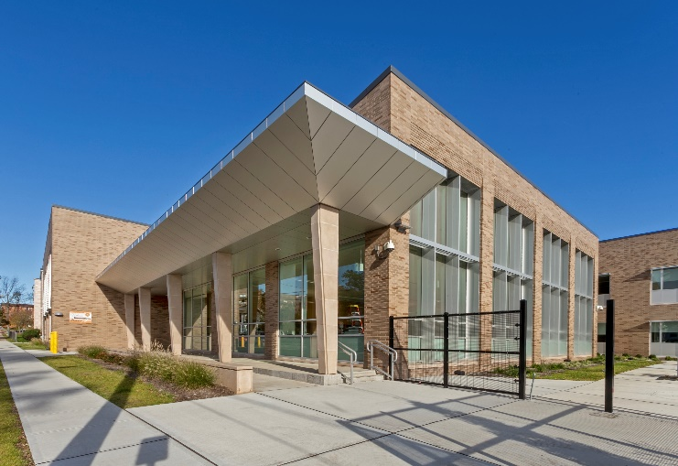
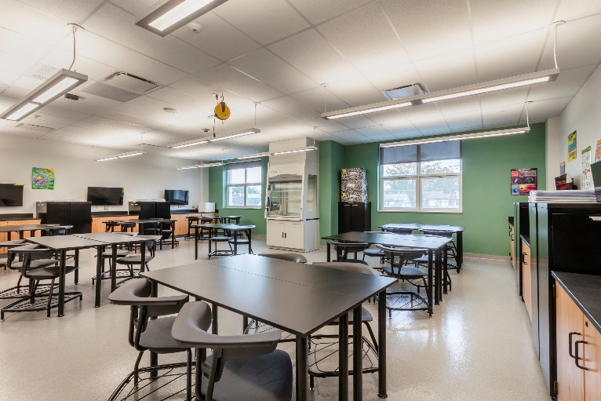
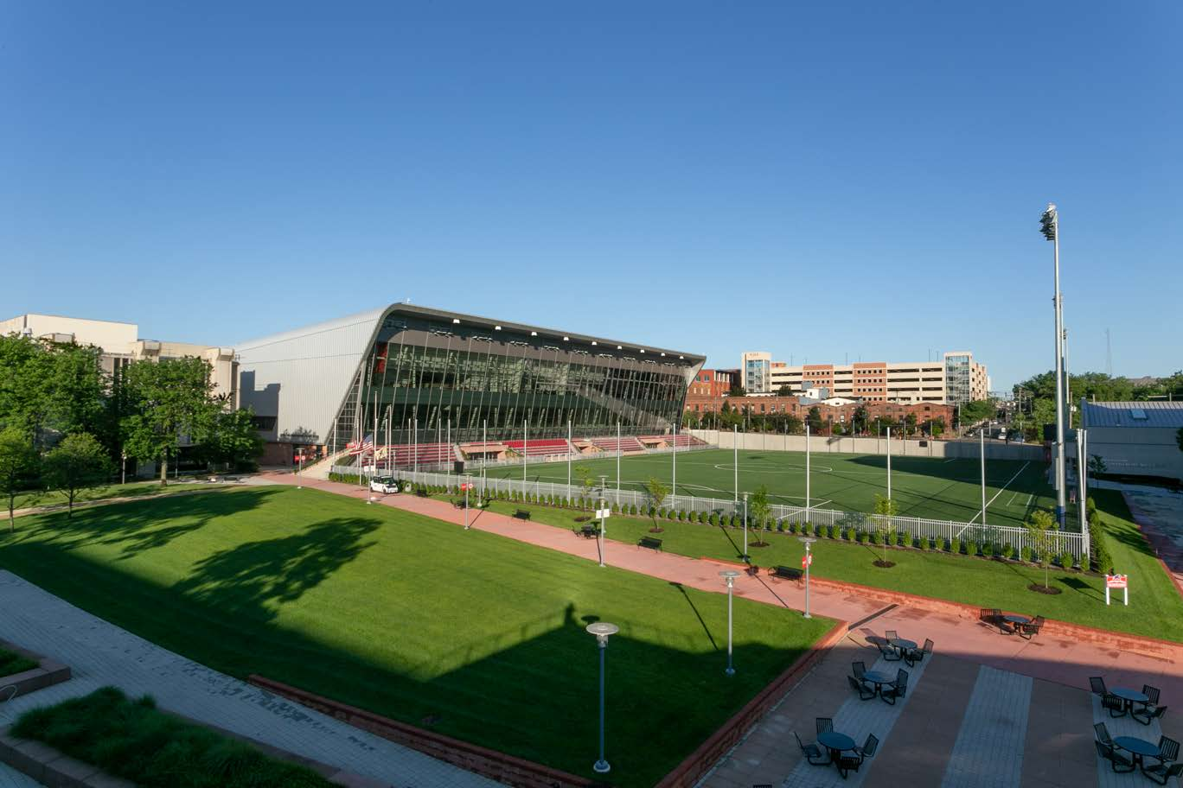
EXTENSIVE K-12 Team Experience
Orange High School
Paterson Middle School
NJIT Wellness and Events Center
Orange School District
Dr. Gerald Fitzhugh
Superintendent
973.677.4000
New Jersey School Development Authority
Joseph Lucarelli
Director, Program Operations
609.858.5373
New Jersey Institute of Technology
Andrew Christ, PE
Sr. Vice President
Real Estate Development and Capital Operations
973.596.5770
Notes:
Outward vs inward facing

Slide 5
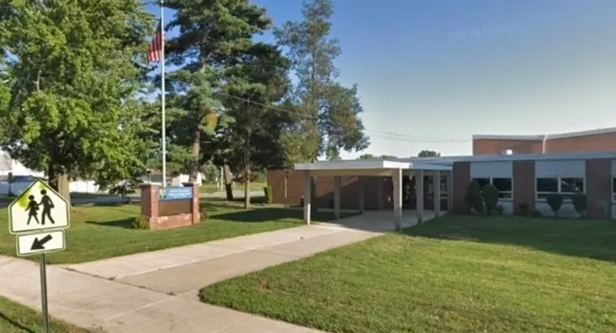
PROJECT UNDERSTANDING: Keys to Success
WE FULLY UNDERSTAND THE GOALS OF YOUR PROJECT
AND HOW BEST TO STRUCTURE OUR APPROACH TO MEET YOUR NEEDS
Daily hands-on approach to construction management and quality with
a high level of communication and safety
Well-developed schedule created with and for each school’s needs and programmatic considerations
Identification and processing of
long lead items, addressed proactively

Slide 6

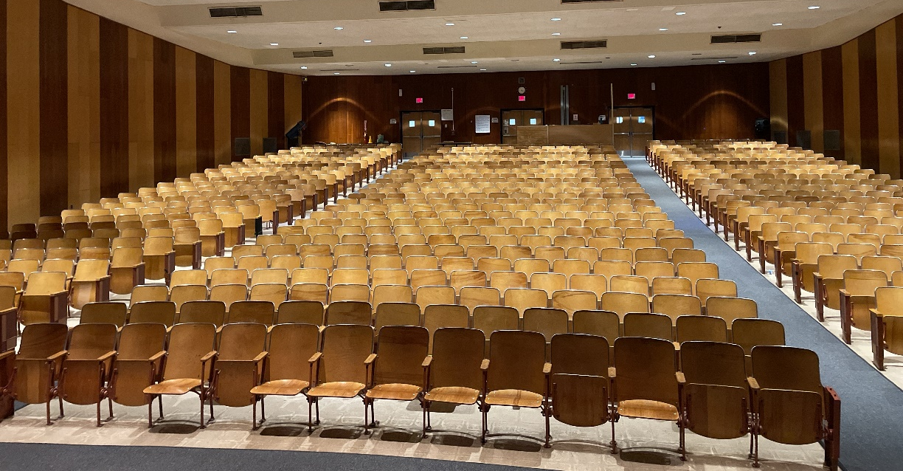
Management Approach: Pre-Construction
Comprehensive Upfront Process
  Bid Packages and Construction Documents – reviewed closely
  Constructability review
  Critical school schedule considerations
Preparing for the Bid
  Long lead planning for materials
  Full estimate with complete divisional breakdowns
  Work with the architect and engineer to address any needed changes
  Incorporate inputs from Board and individual schools
  Advertise and broadcast solicitation
  Preliminary milestone schedule and budget
Post Bid
  Tabulate bids, verify submissions, make recommendations for award
  Establish intervals for project team meetings and communication protocols

Slide 7
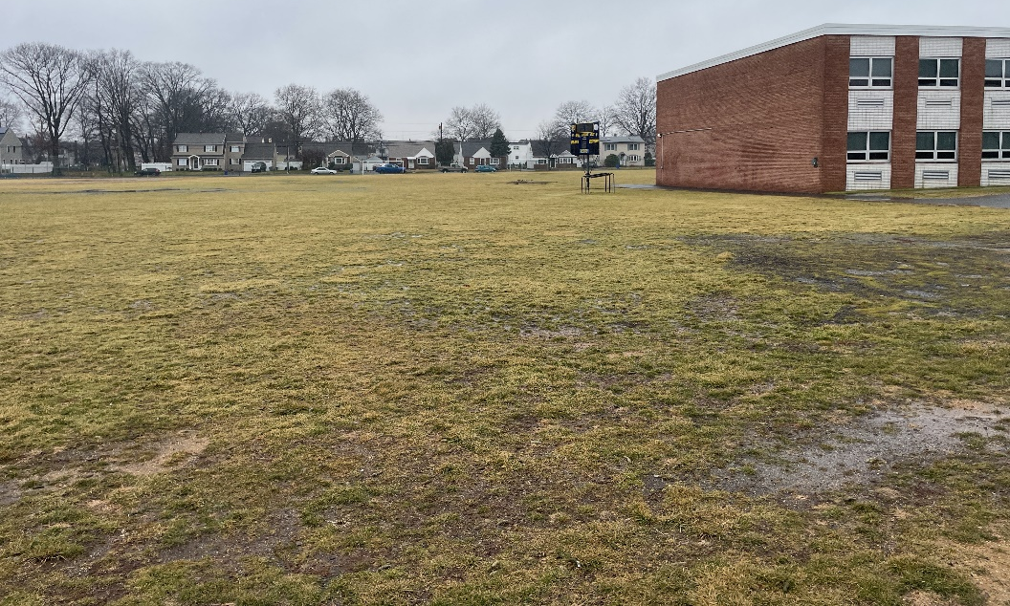
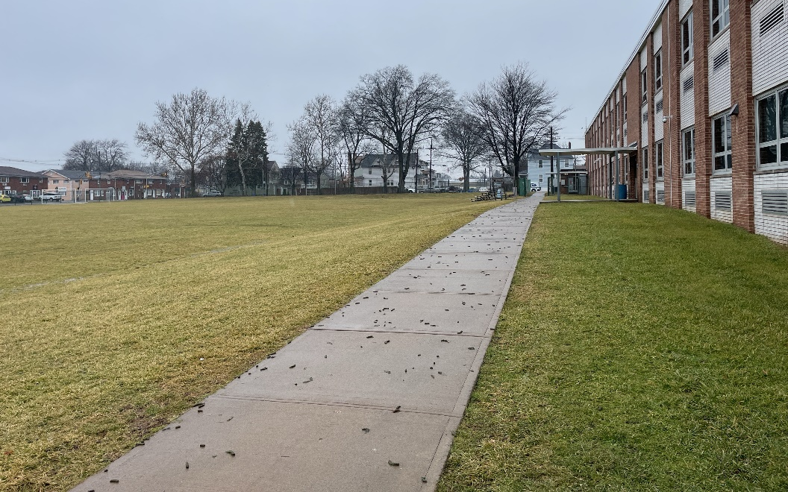
Management Approach: Construction
Safety First
  Occupied construction at the school’s campus
Adherence to the planned schedule
Continuous communication between the owner and construction teams
Daily observation of construction activities – hands-on interactions with the full construction team
Immediate and active attention to issues through resolution
Opportunities for community and student engagement

Slide 8





Management Approach: Project Control Systems
Project Management Systems and Function
Budget
Spend Authority
Funding
Cost
Contracts
Task Orders
Amendments
Change Orders
Forecasts
Invoices
Pay Apps
Direct Expenses
Schedule
Milestones
Master Project Schedule
Risk Management
Cash Flow
Document
Contracts &
Change Orders
Drawings, Specs, Bulletins
Project Reports
CM Construction Schedule
Project Correspondences
Collaboration
RFIs
Submittals
PCOs
Field Reports
Non-Conformance Notices
Issues Tracking
Meeting Minutes

Slide 9
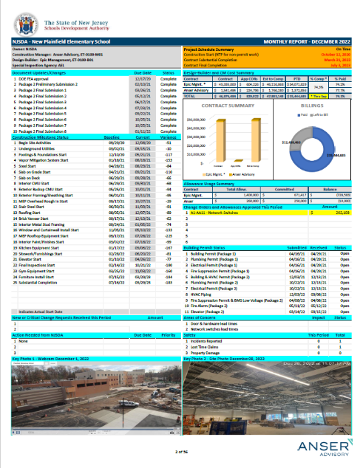


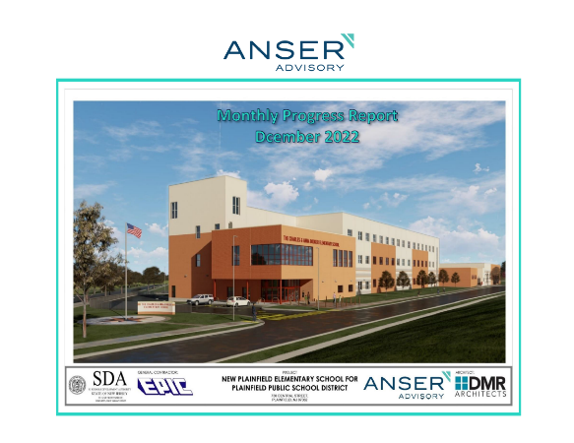
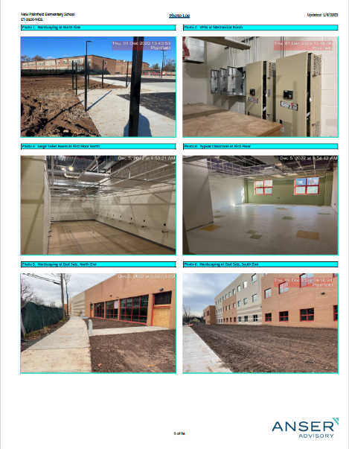
management approach: Construction Administration
and Document Control
Better Decisions with Better Data
Single source
of the facts
Transparency
Eliminate Wasted and Misaligned Effort
Control
Accelerate but
Stay in Control
Track
Performance
Increased Efficiency
Through Consistency

Slide 10
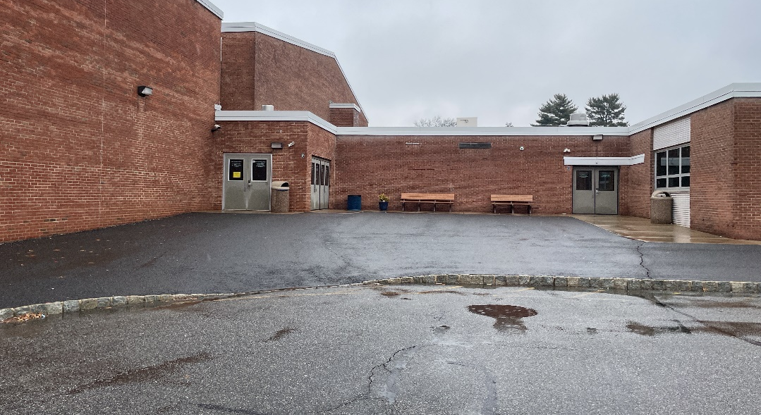
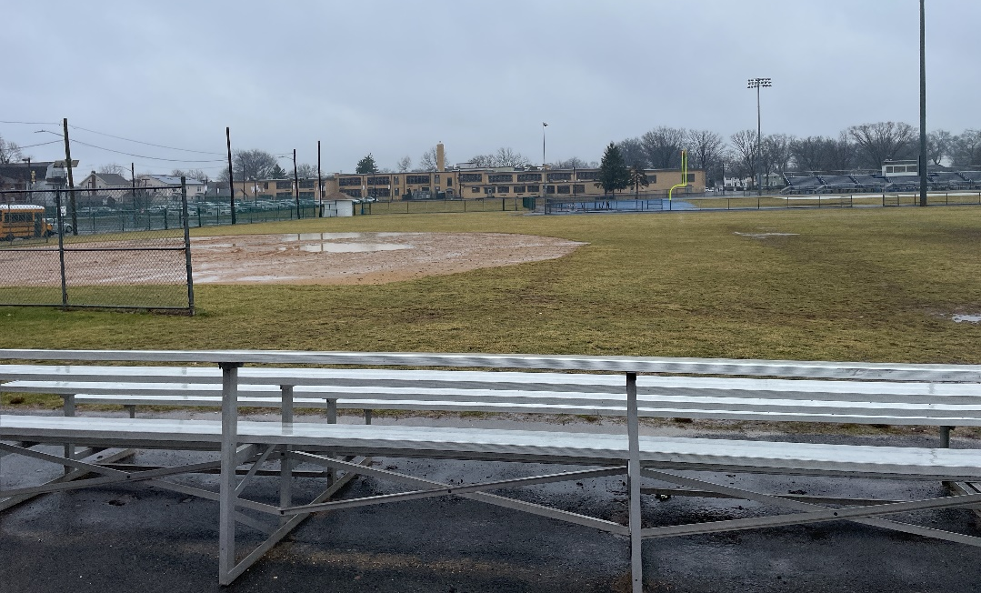
Management Approach: CLOSEOUT
Proactive approach that starts at pre-construction
Closeout systems and organization established from project initiation
Assist the contractor with Building Department
Equipment commissioning, startup, and training complete
Verify documentation submitted and approved
Facilitate Certificate of Occupancy and permits close-out process
Final reconciliation of pay applications and change orders vs. purchase orders

Slide 11
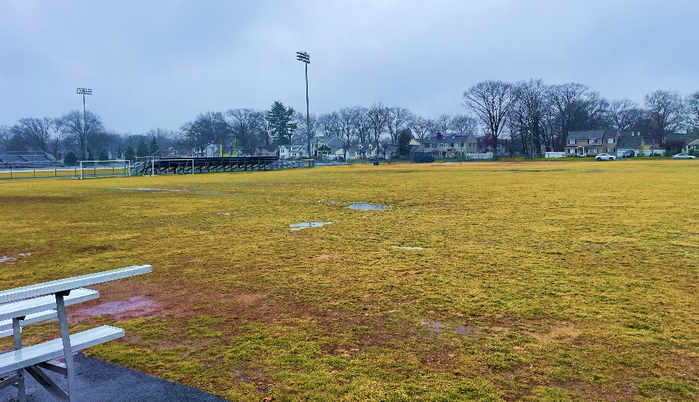
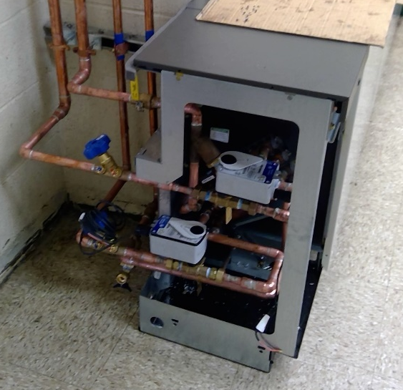
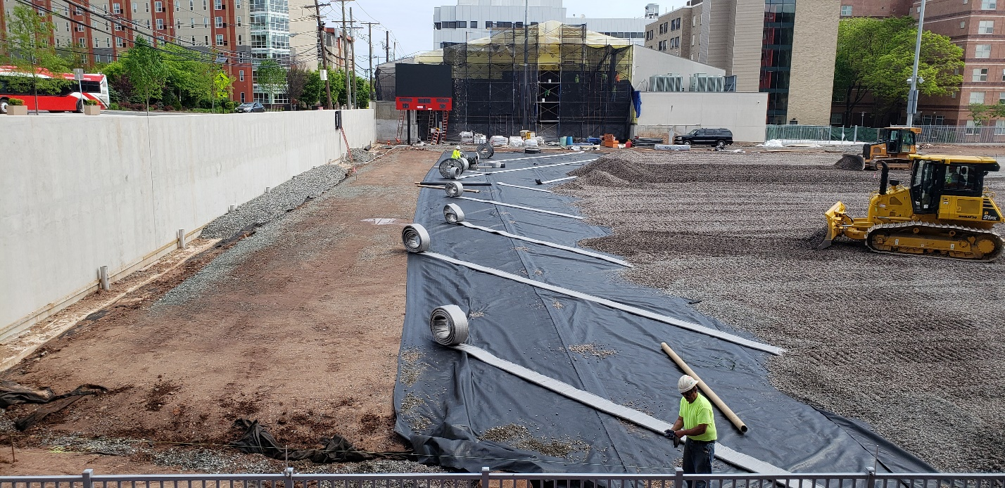
Lessons Learned
WE LEVERAGE LESSONS LEARNED FROM SIMILAR PROJECTS
TO EFFECTIVELY EXECUTE YOUR PROJECT
Athletic Field improvements - Turf Field
  Design phase geotechnical investigation and report is key to understanding subsurface conditions.
  Subbase compaction most critical, proof roll testing must pass.
  Proper grading of subbase insures adequate draining
  Stone base layers must include variable size aggregate to insure proper drainage.
  Modern surveying equipment for final certification
Unit Ventilators
  Insure proper BMS integration, especially during winter months
  Local control may be necessary during installation time to avoid freeze cycles
  Incorporate isolation valves at each unit for servicing
  Replacing existing mains is recommended, if remaining, a filtration system should be incorporated into design

Slide 12


THE RIGHT TEAM FOR KENILWORTH
We are currently providing construction management services on several educational projects that total $500 Million worth of construction locally.
Relationship and experience working with your design firm, SSP Architectural Group.
We bring real lessons learned through recently completed school projects that included identical scopes.
John is 10 minutes from the school facilities.
Notes:
Deb

Slide 13
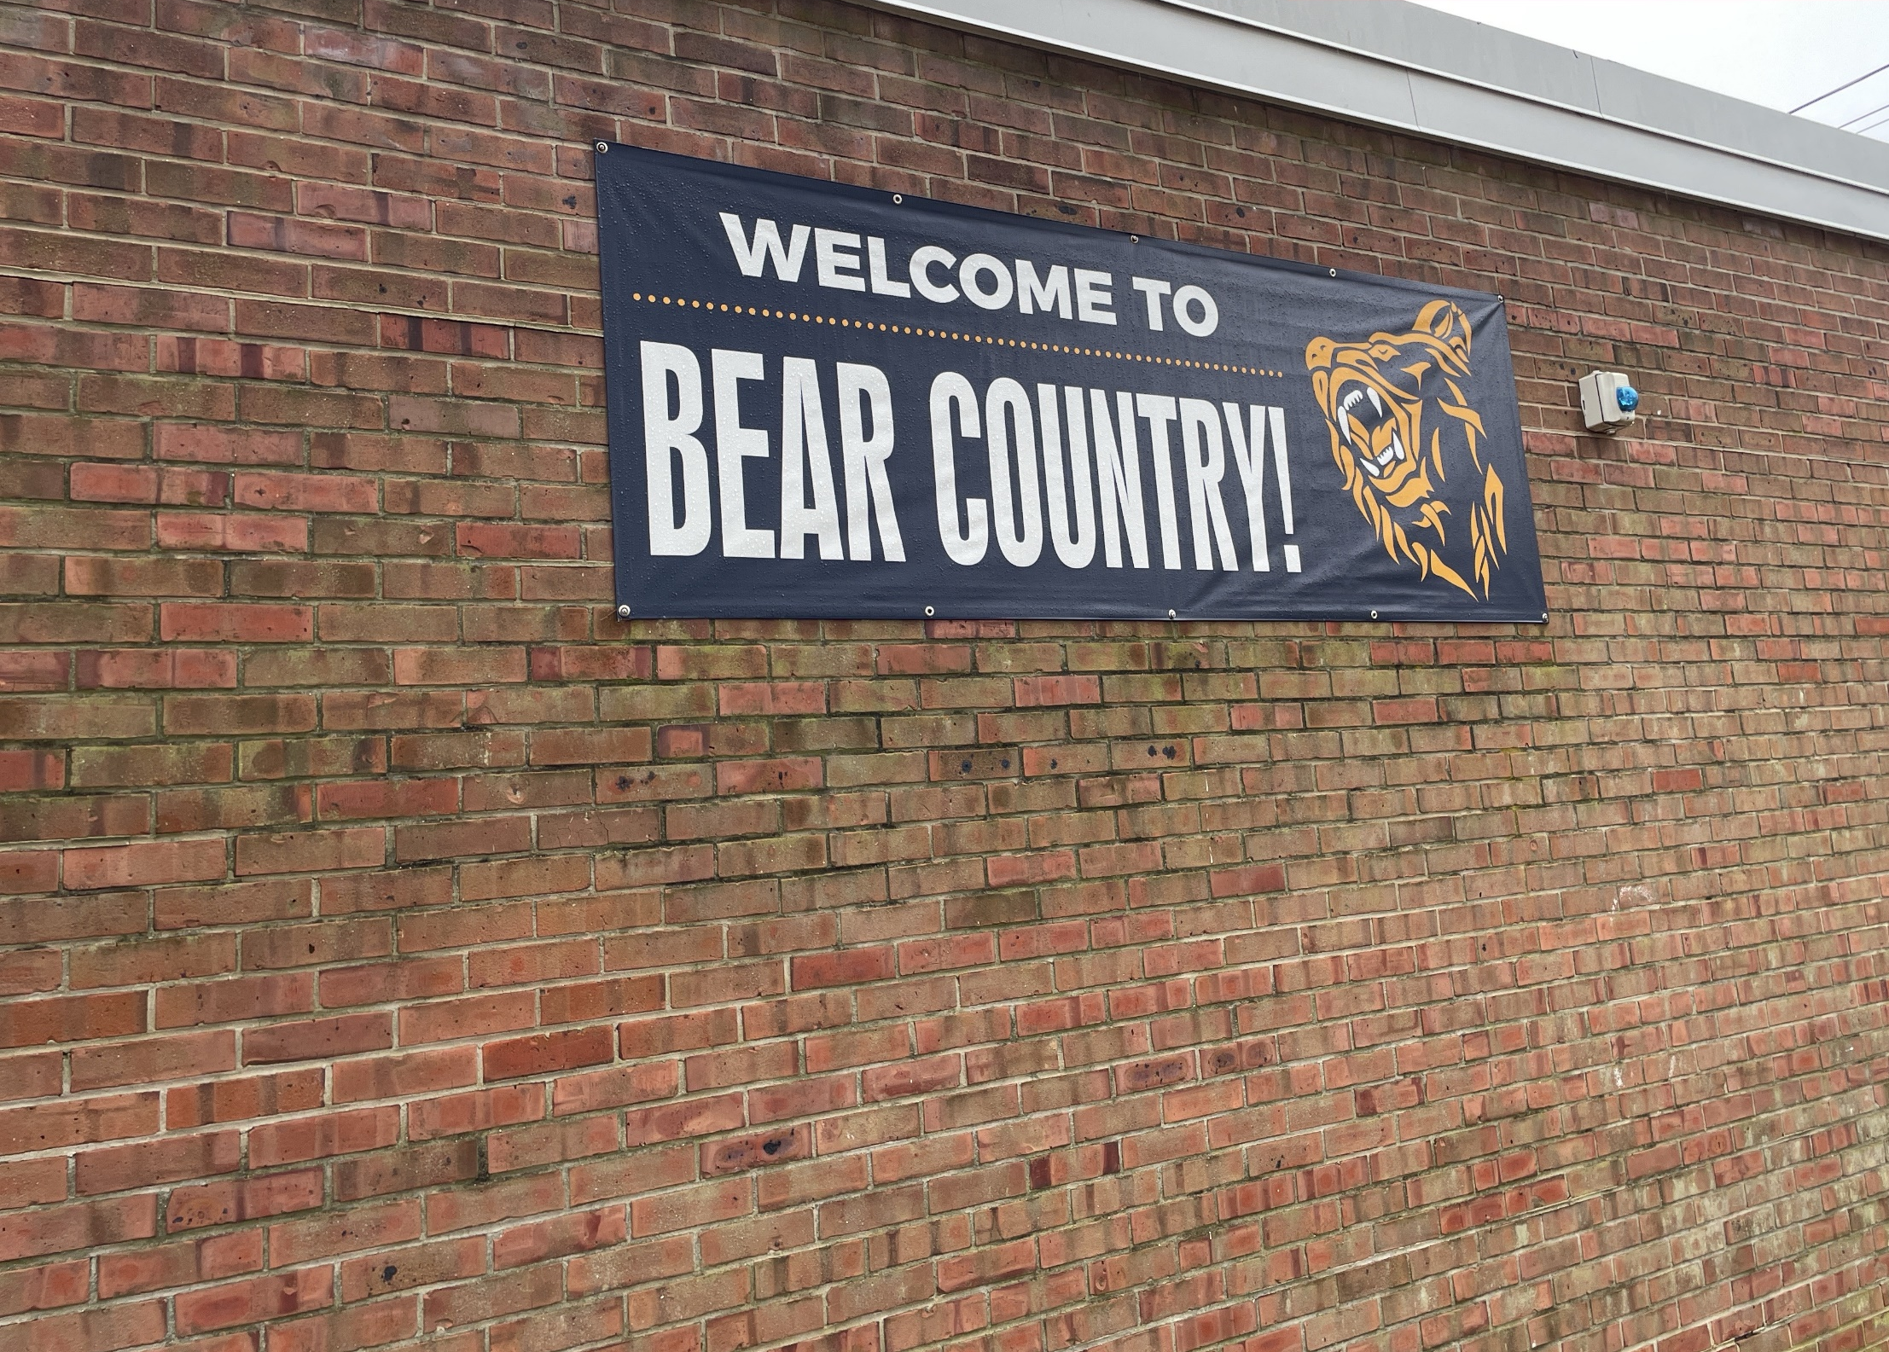
QUESTIONS?

